Slide 1




NEXT GEN EMPLOYABILITY PROGRAM
Creating a future-ready workforce
Team Members
College Name
Student Name : Freedan Jeremiah
Student ID : au311121205020
Loyola ICAM college of engineering and technology

Slide 2

CAPSTONE PROJECT SHOWCASE
Project Title
Music Web Application using Django Framework
Abstract | Problem Statement | Project Overview | Proposed Solution | Technology Used | Modelling & Results | Conclusion

Slide 3
Abstract
The Music Web Application using Django Framework is a comprehensive platform designed to provide users with a seamless and immersive experience in accessing and managing music content online. Leveraging the powerful features and flexibility of Django, a high-level Python web framework, this application offers a robust set of functionalities for both music enthusiasts and artists alike.
Source :
https://github.com/freedanjeremiah/Music-web-application-using-django-framework-.git

Slide 4
Problem Statement
In today's world, listening to music online can be confusing. There are so many different apps and websites, and it's hard to find one that has all the music you like and is easy to use. Plus, it's tough for new artists to get their music out there and make money from it.
To make things worse, some people share music illegally, which hurts artists and the music industry as a whole. And on top of all that, most music apps don't let you connect with other music fans or artists.
So, we need a new kind of music website that brings everything together in one place. It should have all the music you love, help new artists get discovered, and make sure artists get paid for their work. Plus, it should let you chat with other music fans and even collaborate with artists. This way, everyone can enjoy music in a fair and fun way.
Source :
https://github.com/freedanjeremiah/Music-web-application-using-django-framework-.git

Slide 5
Project Overview
MyMusic is an innovative web application designed to revolutionize the way people discover, enjoy, and interact with music online. It aims to address the challenges faced by both music enthusiasts and aspiring artists by providing a unified platform that offers seamless music streaming, robust artist promotion tools, and vibrant community engagement features.
Source :
https://github.com/freedanjeremiah/Music-web-application-using-django-framework-.git

Slide 6
Proposed Solution
.
MyMusic is a groundbreaking music streaming platform that aims to provide a comprehensive solution to the challenges faced by both music enthusiasts and aspiring artists in the digital music landscape.
MyMusic offers a user-friendly interface that aggregates a vast library of songs, albums, and playlists from various genres and artists, providing users with a seamless and intuitive music discovery and playback experience.
Personalized Recommendation Engine:
Leveraging advanced machine learning algorithms, MyMusic delivers personalized music recommendations tailored to each user's unique listening preferences, habits, and feedback, ensuring a curated and enjoyable music discovery journey.
Artist Empowerment and Promotion Tools:
Source :
https://github.com/freedanjeremiah/Music-web-application-using-django-framework-.git

Slide 7
MyMusic provides independent artists with a dedicated platform to showcase their talent, connect with fans, and promote their music. Artists can create profiles, upload their tracks, share updates, and engage with their audience, fostering a vibrant and supportive community.
Engaging Community Features: MyMusic fosters a dynamic and interactive music community where users can connect, collaborate, and share their passion for music. From user-generated playlists and discussion forums to live events and virtual concerts, MyMusic offers various opportunities for users and artists to engage with each other and participate in the music ecosystem.
Discover Your Soundtrack: MyMusic puts the spotlight on you, offering personalized music recommendations tailored to your unique tastes and preferences. Whether you're into indie rock, hip-hop, or classical, MyMusic curates playlists and suggests new tracks that resonate with your vibe, ensuring you're always in tune with the latest and greatest tunes.
Source :
https://github.com/freedanjeremiah/Music-web-application-using-django-framework-.git

Slide 8
MyMusic is committed to fair compensation for artists and rights holders. Through transparent revenue-sharing mechanisms and rigorous copyright enforcement measures, MyMusic ensures that artists receive rightful compensation for their creative contributions.
Interactive Community Features:
MyMusic cultivates an engaging music community where users can connect, collaborate, and share their passion for music. Features such as user-generated playlists, discussion forums, and live events facilitate meaningful interaction and collaboration among users and artists.
Cross-Platform Accessibility:
MyMusic offers seamless access across multiple devices and platforms, including desktops, laptops, smartphones, and tablets, enabling users to enjoy their music library anytime, anywhere.
Source :
https://github.com/freedanjeremiah/Music-web-application-using-django-framework-.git

Slide 9


Technology Used
Front-end
Back-end
Source :
https://github.com/freedanjeremiah/Music-web-application-using-django-framework-.git

Slide 10
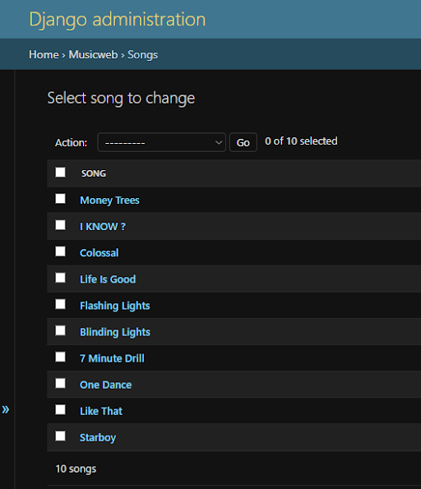
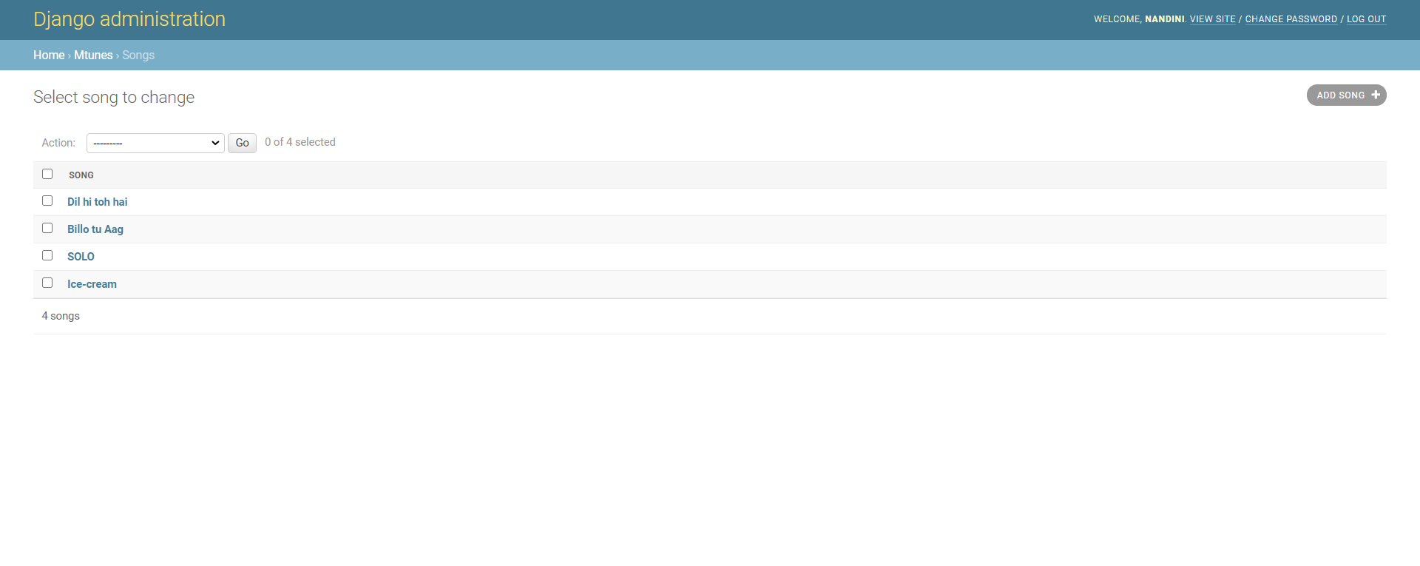
Modelling & Results
Source :
https://github.com/freedanjeremiah/Music-web-application-using-django-framework-.git

Slide 11
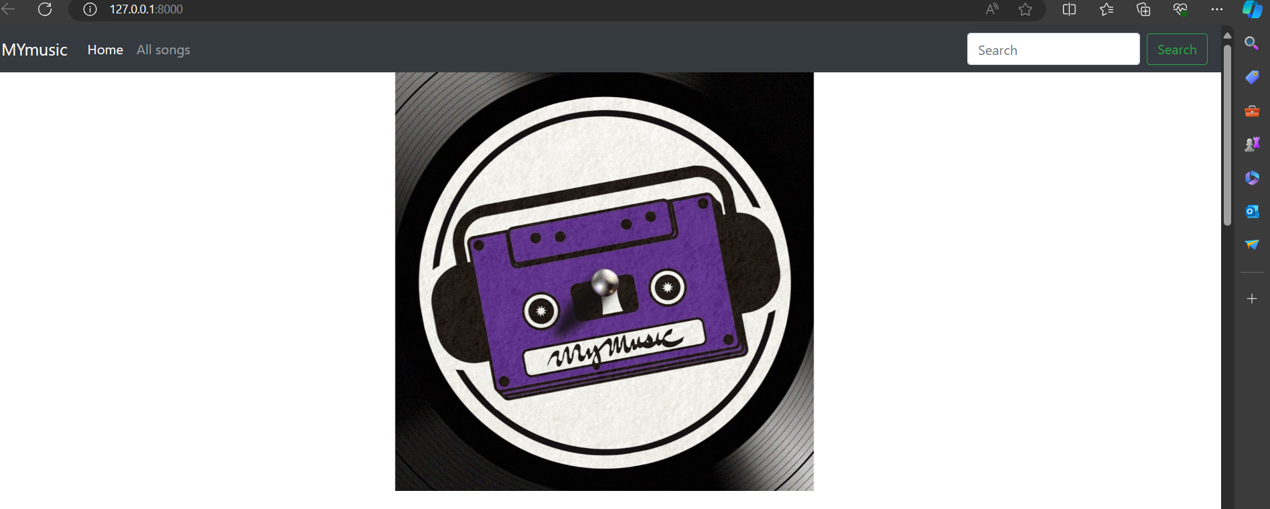
Homepage

Slide 12
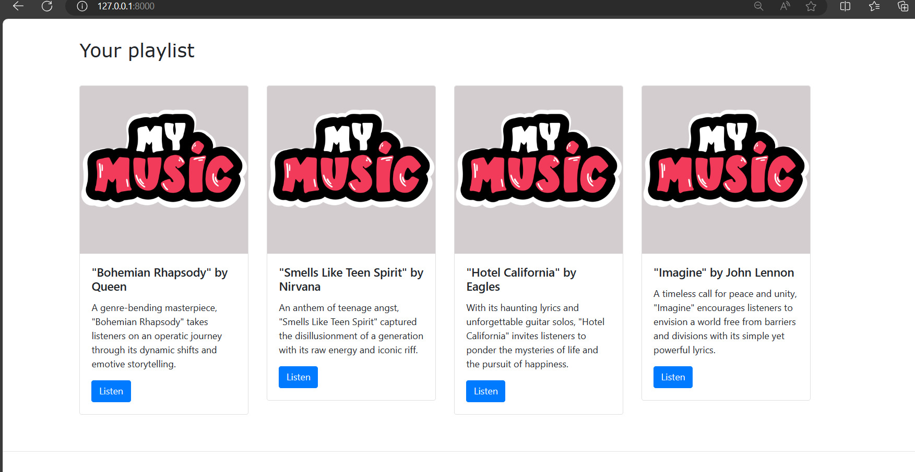
Playlists -Page

Slide 13
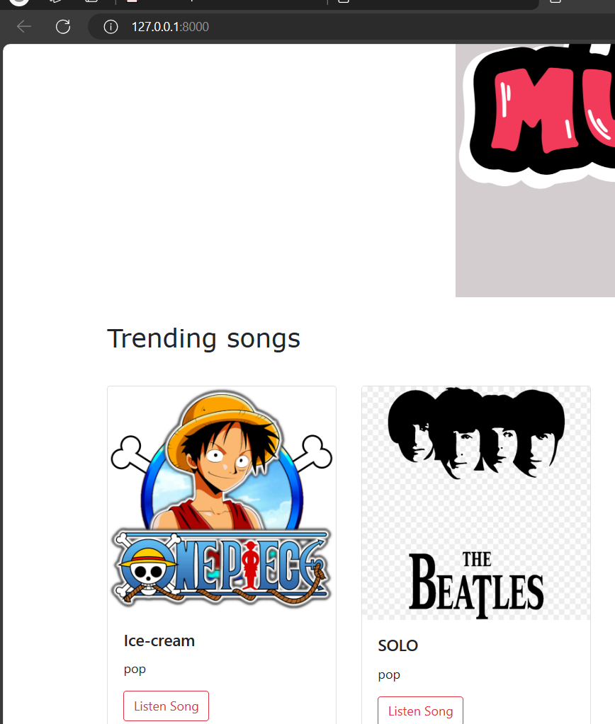
Trending -Page

Slide 14
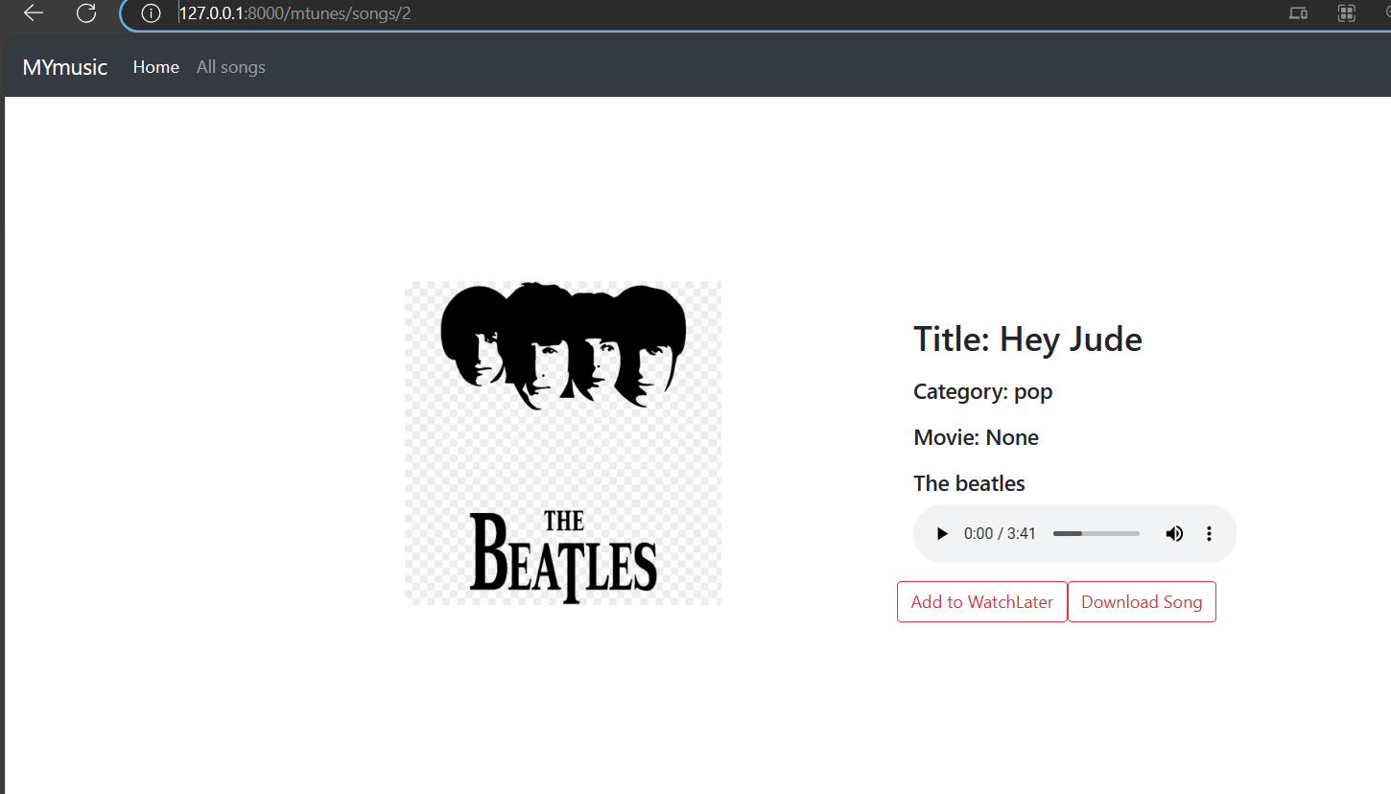
Song-Page

Slide 15
Future Enhancements:
Implement advanced music recommendation algorithms based on user behavior, social interactions, and contextual factors.
Introduce AI-powered features such as mood-based playlists, smart radio stations, and collaborative filtering.
Interactive Artist Collaboration:
Enable artists to collaborate and users through virtual jam sessions, remix contests, and collaborative playlist creation.
Develop specialized programs and initiatives to support emerging artists and promote diverse music genres.
Partner with independent labels and cultural organizations to showcase underrepresented voices and emerging talent.
Monetization and Revenue Streams:
Explore additional revenue streams for artists, including ticket sales for virtual concerts, merchandise sales, and fan subscriptions.
Introduce premium features and subscription tiers for users, offering ad-free listening experiences and exclusive content access.

Slide 16
Conclusion
In conclusion, MyMusic is poised to revolutionize the music streaming landscape by addressing the diverse needs of both users and artists. Through a comprehensive suite of features and a commitment to innovation, MyMusic aims to create a dynamic and inclusive platform that fosters discovery, creativity, and community engagement.
By leveraging advanced recommendation algorithms, fostering artist collaboration, and promoting emerging talent, MyMusic will offer users unparalleled access to a diverse range of music while providing artists with the tools and support they need to thrive in the digital age. Moreover, with a focus on accessibility, inclusivity, and continuous optimization, MyMusic is committed to providing a seamless and enjoyable music experience for all users, regardless of their background or abilities.
Source :
https://github.com/freedanjeremiah/Music-web-application-using-django-framework-.git

Slide 17
Thank You!
Notes:
Thank You !!

